Slide 1
Widget Development
Focus Area: Front-end
Notes:
Requirements:
- Project created with Launchpad Archetype
- YAPI
Familiarity with Portal Manager
Familiarity with Foundation XSD (know how to create xml’s to import catalog items)

Slide 2
Training Overview
Group Workshop
Back-end
Front-end
Services
Integration
Content
Services
Advanced
Security
Widget
Development
Widget Extras
Targeting
Publishing
Container
Development
Foundation
Portal Essentials
Portal Technologies
Portal Tools
Portal APIs

Slide 3
Objectives
Understanding widgets
Learn how to develop a widget
Best Practices
Backbase coding standards
Notes:
At the end of this module, the trainee should be able to understand what a widget is, and be able to develop his own widget, add functionality, style it, import and use it in the portal manager.
https://www.npmjs.com/org/backbase
https://www.npmjs.com/package/@backbase/generator-widget-lp
npm install --global bb-cli
npm install @backbase/generator-widget-lp @backbase/generator-container –g
In order to follow the various exercises in this training, you will need to refer to the training material available here:
https://github.com/Backbase/training-fe-module-01
MAKE SURE ALL STUDENTS ALREADY HAVE BB-CLI!!!

Slide 4
Understanding Widgets
Widget Development
Notes:
Before developing a widget, trainees need to understand what a widget is. For people that haven’t worked with BB portal before, there might be confusion with things like jquery widgets etc.

Slide 5
What Is a Widget?
“Widgets are autonomous mini-applications, designed to run within a web page. They implement reusable pieces of business logic, with which you can compose your web application.”
Notes:
Key points:
Mini-applications: they contain logic and perform operations, which is different from a ui widget like those defined in jquery ui, or in bootstrap
Autonomous: they should work, by themselves in any page that you use them, without depending on other widgets to function properly. This doesn’t mean that they need to contain all the libraries used. They can depend on js libraries that exist in the global project scope
Reusable: A widget is meant to be used multiple times, in different portals, in the same portal, and some times even in the same page. We need to keep this in mind while developing
Business Logic: Widgets should contain business logic and minimal styling.

Slide 6
Why Backbase Widgets?
Reusability
Maintainability
Common
Skillset
Encapsulation
Notes:
The audience at this point are developers. They need to understand the advantages to them:
You create things that the business can re-use in different places, removing the need to code the same thing again and again.
Easier to debug, because you are debugging in a smaller scope
Logic is contained (mostly) within the widgets and not spread out within the application. Of course there are exceptions. Simply put: if you have a payment widget, you know that you will find most of the logic about making payments in there
Skillset:
HTML5 / XHTML
JavaScript (AMD, jQuery, Angular.js)
CSS
AMD - Asynchronous Module Definition - http://requirejs.org/docs/whyamd.html
nice to have:
Twitter bootstrap
Mustache
LESS.css

Slide 7
Widget Anatomy
Model
Page Instance
Widget Instance
<<extends>>
Portal Catalog
Widget Portal
Catalog Item
<<extends>>
Server Catalog
Widget Server
Catalog Item
TemplateName
Standard_Template
src
widgetChrome
Web Tablet Smartphone
Resources
Widget Definition
(index.html)
Widget Chrome
standard_template
Javascript
CSS
Notes:
Widget architecture is separated in two parts:
The model
You first get a server catalog item, referencing a widget template
Enabling it for a portal creates a portal catalog item
Dropping a widget on a page creates a widget instance
The resources
A physical template file, related to the template the widget is using
A widget definition (aka, the html)
A widget chrome (default or custom) ---- Need some more definition
Some static assets (js, css, images…)

Slide 8
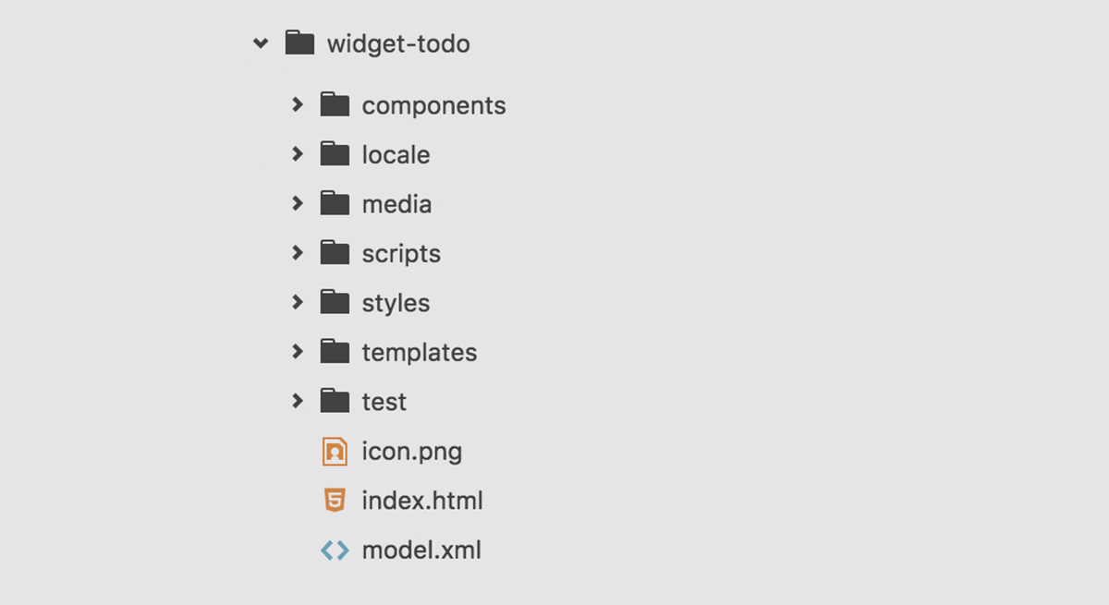
Widget Structure
HTML / Angular templates for content
JS for functionality
CSS for styling
XML for configuration
JSON for localisation
Notes:
You can talk a bit about separation of concerns and how we shouldn’t mix presentation and business logic
Explain:
The folder structure
Icon.png
Model.xml
Optionally, you can write some unit tests for your widget if you have a lot of JavaScript logic

Slide 9
Widget Definition
Widget Development

Slide 10
Widget Definition
HTML5
Document
XML Compliant
Launchpad
UI Components
g:namespace
Notes:
A widget is:
An HTML5 document
Needs to be XML compliant (for the XML parser in CXP…) Because CXP internally uses XML parser so if tag that has been opened is not closed properly then it will not work.
The “g:namespace” provides us with extra HTML tags, like g:include, g:preference, g:onload and it can also enable things like server-side rendering
Since LP12, we can make use of Launchpad UI Components to kick-start widget development

Slide 11
Widget Definition
<!DOCTYPE html>
<html xmlns=http://www.w3.org/1999/xhtml
xmlns:g="http://www.backbase.com/2008/gadget" xml:lang="en">
<head>
<meta http-equiv="Content-Type" content="text/xml; charset=UTF-8" />
<link rel="stylesheet" href="styles/base.css" type="text/css" />
<g:preferences>
<g:preference name="limit" label="Limit" viewHint="user,designModeOnly”
type="text" default="5" />
</g:preferences>
</head>
<body g:onload="requireWidget(__WIDGET__, 'scripts/main')"
class="bt-widget-todo ng-cloak">
<div lp-template="templates/main.ng.html"></div>
</body>
</html>
Notes:
Ng-cloak prevents application to flicker on the page.
Gadget –
Lang – en : language is english
Standard head template
Explain about <lp-template> directive!!!
Angular directive allowing to load a sub template (uses “ng-include” under the hood: https://docs.angularjs.org/api/ng/directive/ngInclude)
Modular template approach, you can create sub templates / partial templates
DO NOT USE FOR MOBILE WIDGETS!!! (problem with loading relative path template files) -> for mobile, write html directly in index.html
DO NOT USE FOR SS rendering (g:include)

Slide 12
Widget Template
<div ng-controller="MainCtrl as mainCtrl">
<h3 ng-bind="mainCtrl.state.title"></h3>
<img ng-src="{{mainCtrl.state.icon}}" alt="{{mainCtrl.state.title}}" />
</div>
Notes:
Ng template be aware that the controller is here

Slide 13
Markup
Use project-specific classes on the body tag and subsequent elements
Try to re-use Launchpad UI Components as much as possible
Do not write the HTML directly in the index.html file (except for mobile / server-side rendering)
Do not use classes as JavaScript selectors
Do not use ID attributes
No inline JavaScript
No inline CSS
Notes:
Always put a class on your body like this: <project prefix>-<widget name>, eg. bt-todo.
Try to re-use Launchpad UI Components as much as possible when developing the HTML of your widget
Do not write the HTML directly in the index.html file, use the scaffolded template file for this, together with the provided “lp-template” directive (except mobile / ssr)
Prefix all your classes that are widget-specific with your widget class. For example, for a sidebar use: bt-todo-sidebar.
Don't mix classes for styling and JavaScript hooks.
Don’t use IDs attributes -> use data attributes instead
Don't write inline JavaScript.
Don't write inline CSS.

Slide 14
Exercise: Create Your First Widget
Scaffold a “Todo” widget structure using the “bb generate” command of bb-cli (generate an “widget-lp”)
Open the template, add a heading
Import your widget in the Enterprise Catalog and enable it for your portal
Notes:
Make sure that at the end of the exercise, everything is set for the next exercise. If not, give them the solution.
https://www.npmjs.com/org/backbase
https://www.npmjs.com/package/@backbase/generator-widget-lp
npm install --global bb-cli
npm install @backbase/generator-widget-lp @backbase/generator-container –g
Things to do:
Change something and see the change only after clearing cache:
http://localhost:7777/portalserver/ps_statistics/ehcache
or
<systemProperty>
<name>net.sf.ehcache.disabled</name>
<value>true</value>
</systemProperty>
Change preferences and see the change only after re-importing
Break the rendering by putting a <br> (without closing the tag) in the html

Slide 15
Widget Namespace
g:preferences
g:onload
g:include
g:model
Notes:
G namespace - https://my.backbase.com/docs/product-documentation/documentation/portal/5.6.1/references_widgetnamespace.html#/list
Custom namespace providing extra tags for advanced widget functionality
Gadgets library
G:preferences: exposes preferences to end users (enabling “personalisation”)
G:onload: executes some JS logic
G:include: includes dynamic content in a widget. Used when consuming camel routes. Also used by ICE widgets
G:model: includes lists of items returned by a query and renders them according to a Mustache template (example: navigation widget) - https://my.backbase.com/docs/product-documentation/documentation/portal/5.6.1/widgetnamespace_model.html#/list
A good example widget-navbar/index.html

Slide 16
Adding a Preference to model.xml
<catalog>
<widget>
<name>widget-todo</name>
<contextItemName>[BBHOST]</contextItemName>
<properties>
...
<property label="Limit" name="limit" viewHint="user,designModeOnly">
<value type="string">5</value>
</property>
...
</properties>
</widget>
</catalog>
Notes:
Example of using g:namespace
<g:preferences>
<g:preference name="limit" label="Limit" viewHint="user,designModeOnly"
type="text" default="5" />
</g:preferences>

Slide 17
Adding a Preference to Widget Definition
<!DOCTYPE html>
<html xmlns=http://www.w3.org/1999/xhtml
xmlns:g="http://www.backbase.com/2008/gadget" xml:lang="en">
<head>
<meta http-equiv="Content-Type" content="text/xml; charset=UTF-8" />
<link rel="stylesheet" href="styles/base.css" type="text/css" />
<g:preferences>
<g:preference name="limit" label="Limit" viewHint="user,designModeOnly"
type="text" default="5" />
</g:preferences>
</head>
<body g:onload="requireWidget(__WIDGET__, 'scripts/main')"
class="bt-widget-todo ng-cloak">
<div lp-template="templates/main.ng.html"></div>
</body>
</html>
Notes:
Example of using g:namespace
<g:preferences>
<g:preference name="limit" label="Limit" viewHint="user,designModeOnly"
type="text" default="5" />
</g:preferences>

Slide 18
Exercise: Create Your First Widget
Add a “limit” preference in to your Todo widget
Reimport your widget in the Enterprise Catalog to sync the new property
Notes:
Make sure that at the end of the exercise, everything is set for the next exercise. If not, give them the solution.
Things to do:
Change something and see the change only after clearing cache:
http://localhost:7777/portalserver/ps_statistics/ehcache
or
<systemProperty>
<name>net.sf.ehcache.disabled</name>
<value>true</value>
</systemProperty>
Change preferences and see the change only after re-importing
Break the rendering by putting a <br> (without closing the tag) in the html
Try to demonstrate inheritance of the limit preference

Slide 19
Launchpad UI Components
Reusable building blocks for widgets

Slide 20
What are LP UI Components ?
Launchpad 12 introduces the new UI Components Library:
Reusable blocks of html
Set of Angular.js directives
Optionally, with some small js logic attached to it
Tested cross-browser
Easily customizable via theming
Logic is extendable by adding your own directives
When building custom widgets, you should try to reuse UI components as much as possible.
Notes:
Explain LP UI Components are:
a set of reusable piece of html
optionally with some JavaScript logic
Easily customizable via theming
Already cross-browser tested
It is, indeed, similar to the new Angular Material Components https://material.angularjs.org/latest/#/

Slide 21
How to use Launchpad UI Components
You can consult documentation about the available UI components directly from your local CXP installation, by making use of the styleguide.

Slide 22
Styleguide Demo
Let’s see how we can run the styleguide and use it to access the Launchpad UI Components Library documentation:
Open your terminal and navigate to /path/to/your/cxp/server/styleguide
Type ‘sh build.sh’ on Unix/ OSX (or ‘build’ on Windows) to install the styleguide
Type ‘sh run.sh’ on Unix / OSX (or ‘run’ on Windows) to start the styleguide server
In your browser, go to http://127.0.0.1:8080/ to access the documentation
Notes:
D:\Projects\DCX\Backbase\Projects\TrainingDemos\styleguide

Slide 23
Widget Functionality
Widget Development

Slide 24
Widget Functionality
RequireJS / AMD
Widget
Object
CommonJS
AngularJS
Notes:
If audience is not familiar, take a few minutes to explain:
RequireJS (http://requirejs.org/) -> module loader – loads only the modules you need
CommonJS (http://www.commonjs.org/) -> common js definition for isomorphic code Black boxing the launch-pad components
AngularJS -> MVVM framework
MVVM facilitates a separation of development of the graphical user interface – be it via a markup language or GUI code – from development of the business logic or back-end logic (the data model). The view model of MVVM is a value converter;^{[1]} meaning the view model is responsible for exposing (converting) the data objects from the model in such a way that objects are easily managed and presented. In this respect, the view model is more model than view, and handles most if not all of the view's display logic.^{[1]} The view model may implement a mediator pattern, organizing access to the back-end logic around the set of use cases supported by the view.
Explain widget object is provided to the widget via portal client
AMD - Asynchronous Module Definition - http://requirejs.org/docs/whyamd.html

Slide 25
Resource Aggregation Basic
Bank Portal
<head>
<title>Bank Portal</title>
<link href=“account-balance.css”/>
<script src=“jquery.js”></script>
<script src=“stock-ticker.js”></script>
<script src=“account-balance.js”></script>
</head>
<body>
</body>
My Stocks Widget
<head>
<script src=“jquery.js”></script>
<script src=“stock-ticker.js”><script>
</head>
<body>
</body>
Account Balance Widget
<head>
<link href=“account-balance.css”/>
<script src=“jquery.js”></script>
<script src=“account-balance.js”><script>
</head>
<body>
</body>
25
Notes:
JS dependencies: server-side aggregation based on file name.

Slide 26
Resource Aggregation with Require
Bank Portal
<head>
<title>Bank Portal</title>
<script src=“require.js”></script>
<script src=“require-widget.js”></script>
<link href=“account-balance/styles/base.css”/>
</head>
<body>
</body>
My Stocks Widget: main.js
define( function (require, exports, module) {
...
var deps = [
...
];
...
})
Account Balance Widget: main.js
define( function (require, exports, module) {
...
var deps = [
...
];
...
})
My Stocks Widget: index.html
<head>
</head>
<body g:onload="requireWidget(__WIDGET__, ’script/main‘)">
</body>
Account Balance Widget: index.html
<head>
<link href=“styles/base.css”/>
</head>
<body g:onload="requireWidget(__WIDGET__, ’script/main‘)">
</body>
26
Notes:
Dependency management based on require (client-side).

Slide 27
Widget Functionality – main.js
define( function (require, exports, module) {
'use strict';
module.name = 'widget-todo';
var base = require('base');
var core = require('core');
var ui = require('ui');
// Internal dependencies
var Models = require('./model');
var MainCtrl = require('./controllers/main-ctrl');
var deps = [
core.name,
ui.name
];
// @ngInject
function run() {
// Module is Bootstrapped
}
module.exports = base.createModule(module.name, deps)
.constant('WIDGET_NAME', module.name ) .controller('MainCtrl', MainCtrl ) .factory( 'model', Model )
.run( run );
});
Notes:
This is the main.js file, this is what gets executed by require.js
The only thing you should modify in this file is the array of dependencies, and the run() method if needed
EXPLAIN LP 12 MODULES:
Base: wrapper methods around angular module, require, etc…
Core: core functionality to access widget functionality (preferences, etc…)
UI: set of UI components
Explain ‘use strict’ ?
New directive in ECMAS 5
The purpose of "use strict" is to indicate that the code should be executed in "strict mode".
With strict mode, you can not, for example, use undeclared variables. (Global Variables), or assign a value to a read-only property, or add a property to an object that is not extensible.
https://developer.mozilla.org/en-US/docs/Web/JavaScript/Reference/Strict_mode
Explain the base.createModule === angular.module

Slide 28
Widget Functionality – main-ctrl.js
define(function (require, exports, module) {
'use strict';
// @ngInject
function MainCtrl() {
// var ctrl = this; //self this controller
};
MainCtrl.prototype.$onInit = function() {
// Do initialization here
};
module.exports = MainCtrl;
});
Notes:
This is the widget controller, all the business logic should go in there
ONLY BUSINESS LOGIC !!!
If you need to manipulate DOM elements, use Angular directives instead
Explain “controller as” (http://toddmotto.com/digging-into-angulars-controller-as-syntax/), why we use it and why they should avoid using $scope variables and $scope watchers as much as possible

Slide 29
Widget Functionality – model.js
define(function (require, exports, module) {
'use strict';
/** * @constructor
* @ngInject
*/
function WidgetModel(lpWidget, lpCoreUtils) {
var utils = lpCoreUtils;
var state = {
title: lpWidget.getPreference('title'),
icon: utils.resolvePortalPlaceholders(lpWidget.getPreference('thumbnailUrl')) };
var model = {};
model.getState = function getState() {
return state;
};
return model;
}
module.exports = WidgetModel;
});
Notes:
This is the widget controller, all the business logic should go in there
ONLY BUSINESS LOGIC !!!
If you need to manipulate DOM elements, use Angular directives instead
Explain “controller as” (http://toddmotto.com/digging-into-angulars-controller-as-syntax/), why we use it and why they should avoid using $scope variables and $scope watchers as much as possible

Slide 30
Widget Functionality
Begin your module with "use strict“.
Do not manipulate the DOM in your controller, use directives.
Always work in isolated $scope in directives
Avoid $scope variables and $scope watchers (use “controller as” instead), for performance reasons
Only put business logic in your controllers; if you need to access some API data, create a Launchpad module for it (Angular Service)
Notes:
Begin your module with "use strict“: https://developer.mozilla.org/en/docs/Web/JavaScript/Reference/Strict_mode
Do not manipulate the DOM in your controller, use directives: http://ng-learn.org/2014/01/Dom-Manipulations/
Always work in isolated $scope in directives: https://umur.io/angularjs-directives-using-isolated-scope-with-attributes/
Avoid $scope variables and $scope watchers (use “controller as” instead), for performance reasons: https://thinkster.io/egghead/experimental-controller-as-syntax
Only put business logic in your controllers; if you need to access some API data, create a Launchpad module for it (Angular Service): https://thinkster.io/a-better-way-to-learn-angularjs/services
Refer students to angular development methodology: https://github.com/Backbase/methodology-angular-development

Slide 31
Widget Functionality
<!DOCTYPE html>
<html xmlns=http://www.w3.org/1999/xhtml
xmlns:g="http://www.backbase.com/2008/gadget" xml:lang="en">
<head>
<meta http-equiv="Content-Type" content="text/xml; charset=UTF-8" />
<link rel="stylesheet" href="styles/base.css" type="text/css" />
<g:preferences>
<g:preference name="limit" label="Limit" viewHint="user,designModeOnly”
type="text" default="5" />
</g:preferences>
</head>
<body g:onload="requireWidget(__WIDGET__, 'scripts/main')"
class=“bt-widget-todo ng-cloak">
<div lp-template="templates/main.ng.html"></div>
</body>
</html>
Notes:
Explain:
requireWidget() -
https://my.backbase.com/docs/how-to-guides/widgets-on-steroids-launchpad#/list
Launchpad function that uses RequireJS to call the widget itself
the __WIDGET__ object
You can use a place holder __WIDGET__ in the widget definition that Backbase Portal replaces with the widget view of the current widget (usually of class portalView.backbaseWidget). This object includes any personalization of the user that sent the request.

Slide 32
Exercise: Create Your “Todo” Widget
Create the Todo application, based on the following requirements:
There is a text input and a submit button. The submit button should be disabled, unless there is some text in the input field
When you press the submit button, whatever is in the text input is added in the todos list
Each todo can be marked as done/not done by clicking a checkbox in front of it. The whole row gets a class “bt-todo-done” (no styling)
Each todo should have a button to be able to remove it
No storing required
No need to check for duplicate tasks
Try to use as many Launchpad UI components as possible (refer to the documentation in your local styleguide)
Notes:
Take your time with this exercise.
Be very careful that the outcome is 100% according to the cookbook, explaining practices along the way, base on the mistakes they make. Even the little things, like hardcoding strings in the js code
Bootstrap classes
And Launchpad components
Draw on the board what it should be like

Slide 33
Widget Functionality – Preferences
// Retrieving a preference from the model
lpWidget.model.getPreference('limit');
// Saving a preference to the model
lpWidget.model.setPreference('limit', 8);
lpWidget.model.save();
// Binding a callback when preferences are changed
lpWidget.model.addEventListener('preferencesSaved', function (event) {
console.log(event);
});
Notes:
Explain:
lpWidget is an Angular.js provider which wraps around the __WIDGET__ object
how save() works, and how to persist the data to the server, you need to call save(). Also, you need 1 save() call, no matter how many preferencies you change
Mention that there are other Backbase events that you can bind the same way and point to the documentation.
Urge them to do a console.log(lpWidget) and inspect the object (eg. Check the id as well, the body etc)

Slide 34
Widget functionality – Responsiveness
In your HTML:
<div ng-controller="MainCtrl as mainCtrl">
<div class="container" element-resize="mainCtrl.checkSize(data)"></div>
</div>
In your controller:
define(function (require, exports, module) {
'use strict';
function MainCtrl() {
var ctrl = this;
ctrl.checkSize = function(data) {
console.log('element width', data.width);
console.log('element height', data.height);
};
};
module.exports = MainCtrl;
});
Notes:
Explain that LP 12 comes bundles with a directive called “elementResize”
Usage:
Add ‘element-resize’ attribute to the element
Pass a callback function to the attribute
Define the callback function in your controller
Add some logic based on width / height of element
Advantages:
It does not poll the element every 70ms like the old responsive lib (huge performance gain)
It actually only cares about the size of the element itself, regardless of its environment (thus making your widgets even more reusable)

Slide 35

Widget Functionality – Pubsub
Server
Widget
Back-end
Widget
Back-end
Browser
Portal Client
Widget A
Widget B
Direct message

Slide 36
Widget Functionality – Pubsub
Server
Widget
Back-end
Widget
Back-end
Browser
Client Channels
Portal Client
Widget A
Widget B
Publish
Subscribe
Publish
Subscribe
Notes:
Note:
It is a limitation of lpCoreBus that both the widgets has to be on the same page then only they can exchange the data. In Backbase you can’t pass the data between 2 pages. For that one has to send the data to server and let server pass it to the next page or use location.path of angularJS.
One can save data in local storage or session storage and then can access on next page.

Slide 37
Widget Functionality – Pubsub
// This is how you publish to a channel
lpCoreBus.publish("todos-updated", {totalTodos: 5});
// This is how your subscribe to the channel
lpCoreBus.subscribe("todos-updated", function (data) {
console.log(data.totalTodos);
});
Notes:
TODO: diagram from previous slides
Explain the concept of loosely coupling widgets
Explain how you should use Pubsub for passing data, not for building UI
Explain how you should not abuse Pubsub, and end up hard coupling widgets
Best Practices about pubsub from cookbook (use at your own discretion)
Use the pubsub pattern for communication with components outside the widget. Pubsub pattern is good for avoiding hard coupling the widget with the rest of the portal, but it still is some sort of coupling and should be used with caution.
Don't use pubsub for UI logic. For example if you need to press a button somewhere else in the page and make the widget appear, this should not be solved with pubsub. (chromes, containers and perspectives ( Maximized, Widget – default, Minimized ) are options for solving this problem).
When using subscribe, make sure your widget works without it. Lets assume you have 2 widgets: Filters widget and List widget. The List widget "listens" to a channel that the Filter widget publishes the filter changed event to. The List widget should in any case have some default settings for getting data, even if the Filter widget is not present in the page.
When you publish an event, pass along all the data. Don't depend on DOM or any other structure for pulling the data.
Pubsub is stateless and without any history information and should be treated as such (pass all the data needed with each publish, don't rely on previous states)

Slide 38
Exercise: Enhance Your Widget
STEP 1 - Preferences
Based on your preference, your widget should have a maximum number of not done todos. User shouldn’t be able to add more, until he marks one as done.
STEP 2 - Responsive
Make your Todo widget responsive. When less than 400px, the checkboxes should not appear, and the toggling of done/not done should happen by clicking the whole row.
STEP 3 - PubSub
Create a notification widget. When you add a todo, this notification widget should display for 5 seconds: “Todo added, total todos 5”. Same when a todo is removed, marked as done or not done.
Notes:
Take your time with this exercise. Be very careful that the outcome is 100% according to the cookbook, explaining practices along the way, base on the mistakes they make. Even the little things, like hardcoding strings in the js code.

Slide 39
Widget Styling
Widget Development

Slide 40
Widget Styling
Backbase
Themes
VS
Widget
Styles
Notes:
Before going into styling, you need to explain a couple of things:
Backbase Themes
What the server is, and how our themes are based on Bootstrap/LESS, but they can be built with any other preprocessor or plain CSS
Launchpad Theming is based on the code of Twitter Bootstrap. If you are familiar with Twitter Bootstrap you are already largely familiar with Launchpad Theming
Launchpad Theming builds upon Twitter Bootstrap by adding additional styling for components which are specific to a Backbase Portal environment. All Launchpad specific class names begin with the prefix lp-, so they can be easily distinguished from the class names which mirror Twitter Bootstrap
2) What to put in theme, and what in the widget itself
Talk about OOCSS, reusable components.
As a rule of the thumb, any of the following is theme related:
typography (font styles on headings and paragraphs, related colors)
form elements (any styles on inputs, dropdowns, checkboxes etc)
links and buttons
navigation elements, breadcrumbs
grid system
specific helper classes (eg. clearfix, hidden etc)

Slide 41
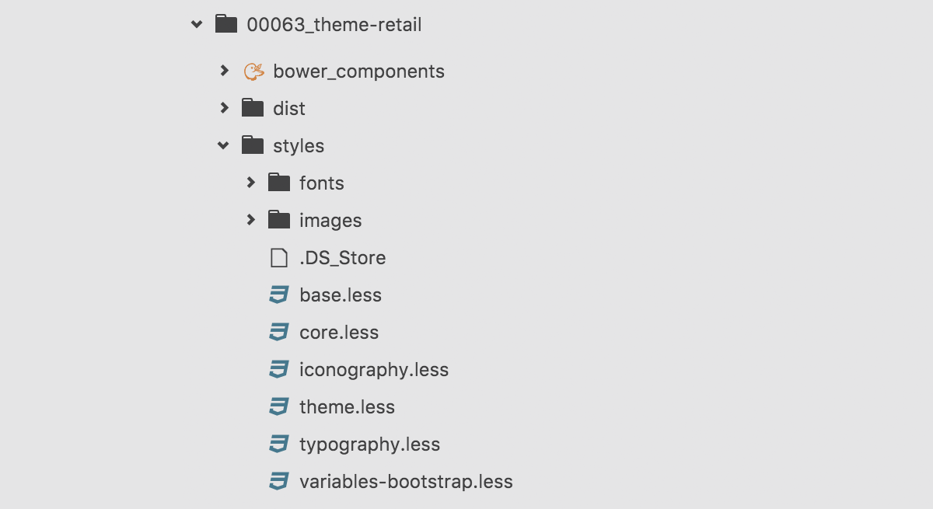
Backbase Theme Server
launchpad-page.soy
themeName
property
Notes:
Boot Strap library is by default included in Backbase.
On the root of theme-retail folder
- Bower install
- bb theme-build
- bb import-item
***************************************************************************
Explanation about how launchpad themes are setup in lp11
First of all, if they do not have gulp installed, they need to run : npm install -g gulp (this can be done from the terminal in any path, and it only needs to be done once for a given computer)
Then, they need to navigate to the launchpad-theme folder and type npm i to install the dependencies needed by Launchpad to run the tasks (this needs to be done once per project)
Finally, they have two commands available:
gulp compile (for a one time compile)
gulp watch (to watch for changes and automatically re compile)
Show them the folder structure. Explain what files they need to change, and how to create a new theme (copying the folder).
Open the statics/collection/bower_components/template-launchpad-page/templates/launchpad-page.soy and show them how the styles are loaded. -
Add themeName property to the master page, if it’s not there by default.
Explain the themeName property and how to change themes

Slide 42
Exercise: Style Your Widget
STEP 1
Using Twitter Bootstrap (getbootstrap.com), add a trash bin icon to your delete button.
STEP 2
Make your delete buttons black, by changing the variable in the default theme.
STEP 3
The todos that are done, should have a strike-through. Todo items that are not done should be bold.
STEP 4
Create a global behavior, using only CSS. When hovering over an element, a button inside it appears. Use this behavior for your “delete todo” buttons.
Notes:
Step 1 = using core bootstrap styles, just in the markup, they shouldn’t need to add any CSS
Step 2 = Change the theme variables and get what they want
Step 3 = Creating some widget styles
Step 4 = Create some theme styles

